Slide 1
Lesson 3 :
Transmission Media
Business Data Communications,

Slide 2
Classes of Transmission Media
Conducted or guided media
  use a conductor such as a wire or a fiber optic cable to move the signal from sender to receiver
Wireless or unguided media
  use radio waves of different frequencies and do not need a wire or cable conductor to transmit signals

Slide 3
Design Factors for Transmission Media
Bandwidth: All other factors remaining constant, the greater the band-width of a signal, the higher the data rate that can be achieved.
Transmission impairments. Limit the distance a signal can travel.
Interference: Competing signals in overlapping frequency bands can distort or wipe out a signal.
Number of receivers: Each attachment introduces some attenuation and distortion, limiting distance and/or data rate.

Slide 4
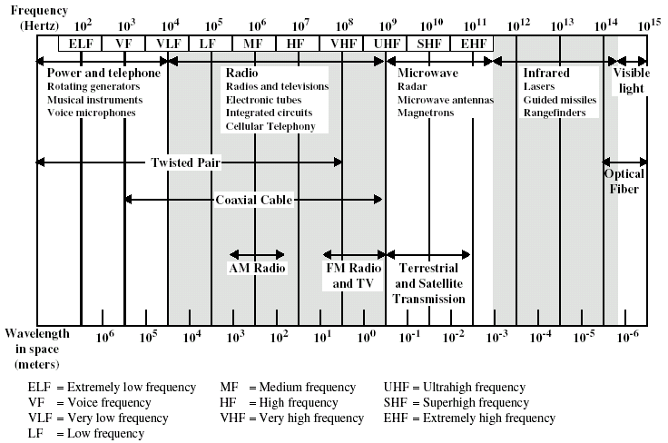
Electromagnetic Spectrum for Transmission Media

Slide 5
Guided Transmission Media
Transmission capacity depends on the distance and on whether the medium is point-to-point or multipoint
Examples
  twisted pair wires
  coaxial cables
  optical fiber

Slide 6
Twisted Pair Wires
Consists of two insulated copper wires arranged in a regular spiral pattern to minimize the electromagnetic interference between adjacent pairs
Often used at customer facilities and also over distances to carry voice as well as data communications
Low frequency transmission medium

Slide 7
Types of Twisted Pair
STP (shielded twisted pair)
  the pair is wrapped with metallic foil or braid to insulate the pair from electromagnetic interference
UTP (unshielded twisted pair)
  each wire is insulated with plastic wrap, but the pair is encased in an outer covering

Slide 8
Ratings of Twisted Pair
Category 3 UTP
  data rates of up to 16mbps are achievable
Category 5 UTP
  data rates of up to 100mbps are achievable
  more tightly twisted than Category 3 cables
  more expensive, but better performance
STP
  More expensive, harder to work with

Slide 9
Twisted Pair Advantages
Inexpensive and readily available
Flexible and light weight
Easy to work with and install

Slide 10
Twisted Pair Disadvantages
Susceptibility to interference and noise
Attenuation problem
  For analog, repeaters needed every 5-6km
  For digital, repeaters needed every 2-3km
Relatively low bandwidth (3000Hz)

Slide 11
Coaxial Cable (or Coax)
Used for cable television, LANs, telephony
Has an inner conductor surrounded by a braided mesh
Both conductors share a common center axial, hence the term “co-axial”

Slide 12
Coax Layers
outer jacket
(polyethylene)
shield
(braided wire)
insulating material
copper or aluminum
conductor

Slide 13
Coax Advantages
Higher bandwidth
  400 to 600Mhz
  up to 10,800 voice conversations
Can be tapped easily (pros and cons)
Much less susceptible to interference than twisted pair

Slide 14
Coax Disadvantages
High attenuation rate makes it expensive over long distance
Bulky

Slide 15
Fiber Optic Cable
Relatively new transmission medium used by telephone companies in place of long-distance trunk lines
Also used by private companies in implementing local data communications networks
Require a light source with injection laser diode (ILD) or light-emitting diodes (LED)

Slide 16
Fiber Optic Layers
consists of three concentric sections
plastic jacket
glass or plastic
cladding
fiber core

Slide 17
Fiber Optic Types
multimode step-index fiber
  the reflective walls of the fiber move the light pulses to the receiver
multimode graded-index fiber
  acts to refract the light toward the center of the fiber by variations in the density
single mode fiber
  the light is guided down the center of an extremely narrow core

Slide 18
Fiber Optic Signals
fiber optic multimode
step-index
fiber optic multimode
graded-index
fiber optic single mode

Slide 19
Fiber Optic Advantages
greater capacity (bandwidth of up to 2 Gbps)
smaller size and lighter weight
lower attenuation
immunity to environmental interference
highly secure due to tap difficulty and lack of signal radiation

Slide 20
Fiber Optic Disadvantages
expensive over short distance
requires highly skilled installers
adding additional nodes is difficult

Slide 21
Wireless (Unguided Media) Transmission
transmission and reception are achieved by means of an antenna
directional
  transmitting antenna puts out focused beam
  transmitter and receiver must be aligned
omnidirectional
  signal spreads out in all directions
  can be received by many antennas

Slide 22
Wireless Examples
terrestrial microwave
satellite microwave
broadcast radio
infrared

Slide 23
Terrestrial Microwave
used for long-distance telephone service
uses radio frequency spectrum, from 2 to 40 Ghz
parabolic dish transmitter, mounted high
used by common carriers as well as private networks
requires unobstructed line of sight between source and receiver
curvature of the earth requires stations (repeaters) ~30 miles apart

Slide 24
Terrestrial Microwave
Applications
Television distribution
Long-distance telephone transmission
Private business networks

Slide 25
Microwave Transmission Disadvantages
line of sight requirement
expensive towers and repeaters
subject to interference such as passing airplanes and rain

Slide 26
Satellite
Microwave Transmission
a microwave relay station in space
can relay signals over long distances
geostationary satellites
  remain above the equator at a height of 22,300 miles (geosynchronous orbit)
  travel around the earth in exactly the time the earth takes to rotate

Slide 27
Satellite Transmission Links
earth stations communicate by sending signals to the satellite on an uplink
the satellite then repeats those signals on a downlink
the broadcast nature of the downlink makes it attractive for services such as the distribution of television programming

Slide 28
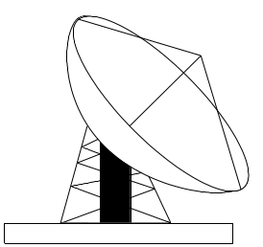
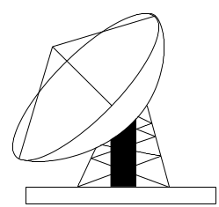
Satellite Transmission Process
satellite
transponder
dish
dish
22,300 miles
uplink station
downlink station

Slide 29
Satellite Transmission Applications
television distribution
  a network provides programming from a central location
  direct broadcast satellite (DBS)
long-distance telephone transmission
  high-usage international trunks
private business networks

Slide 30
Principal Satellite Transmission Bands
C band: 4(downlink) - 6(uplink) GHz
  the first to be designated
Ku band: 12(downlink) -14(uplink) GHz
  rain interference is the major problem
Ka band: 19(downlink) - 29(uplink) GHz
  equipment needed to use the band is still very expensive

Slide 31
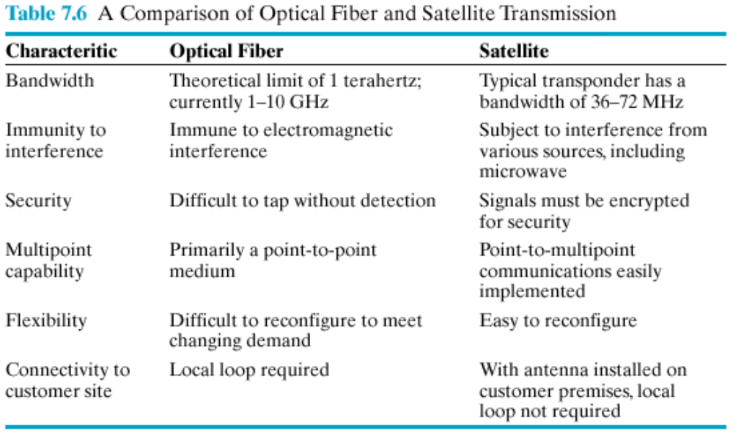
Fiber vs Satellite

Slide 32
Radio
radio is omnidirectional and microwave is directional
Radio is a general term often used to encompass frequencies in the range 3 kHz to 300 GHz.
Mobile telephony occupies several frequency bands just under 1 GHz.

Slide 33
Infrared
Uses transmitters/receivers (transceivers) that modulate noncoherent infrared light.
Transceivers must be within line of sight of each other (directly or via reflection ).
Unlike microwaves, infrared does not penetrate walls.

